Slide 1
Unreimbursed Medical Expenses (UME)
Claims Office Productions

Slide 2
What is a UME
Unreimbursed medical expenses paid by a beneficiary (or by a Veteran's spouse for Veteran awards) may be used to reduce the beneficiary's countable income. A deduction under 38 CFR 3.272(g) for medical expenses is permitted if all the conditions in the table below exist.

Slide 3
Possible Medical Expense
Abdominal supports
-Acupuncture service
-Ambulance hire
-Anesthetist
-Arch supports
-Artificial limbs and teeth
-Back supports
-Braces
-Cardiographs
-Chiropodist
-Chiropractor
-Convalescent home (for medical treatment only)
-Crutches -Vaccines
-Dental service (e.g., cleaning, x ray, filling teeth)
-Dentures
-Dermatologist
-Eyeglasses
-Food or beverages specially prescribed by a physician (for treatment of illness, and in addition to, not as a substitute for, regular diet- physicians statement needed)
-Gynecologist
-Hearing aids and batteries
-Home health services
-Hospital expenses
-Insulin treatment
-Insurance premiums(for medical insurance only)
-Invalid chair
-Lab tests
-Lip reading lessons( designed to overcome a disability)
-Neurologist
-Nursing services( for medical care, including nurse's board paid by claimant)
-Occupational therapist
-Ophthalmologist
-Optician
-Optometrist
-Oral surgery
-Osteopath, licensed
-Pediatrician
-Physical examinations
-Physical therapy
-Physician
-Podiatrist
-Prescription and Drugs
-Psychiatrist
–Psychoanalyst
-Psychologist
-Psychotherapy
-Radium therapy
-Sacroiliac belt
-Seeing-eye dog and upkeep
-Speech therapist
-Splints
-Supplementary med ins.
-Surgeon
-Telephone/teletype for def
-Transportation for med treat.
-Vitamins from Dr.
-Wheelchairs
-Whirlpool baths
-X-Rays

Slide 4
When Should We Apply
Normally, on an annual basis.
Unless the veteran or widow is at max pension or on the $90 rate.

Slide 5
What are the A,B,C Periods
You must be aware of the ABC periods when filing UME.
If it’s a new claim and there are no new large expenses, you will wait until the end of the C period to file UME, even if it’s in the next year.
If, for some reason, there is a new large expense that needs to be reported during the ABC period, ensure you report everything that was previously reported and do a statement to explain the new costs, as the VA Form 21-8416 only gives a snapshot and not an explanation of the new expense.
You can goof up a pension by reporting it incorrectly while in the ABC period.

Slide 6
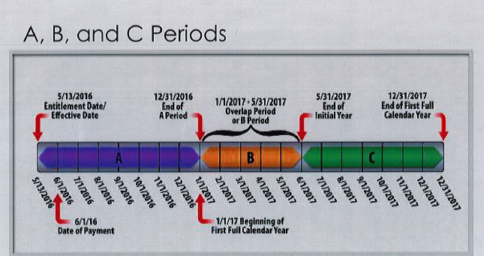
What are the A,B,C Periods

Slide 7
How Should We Apply & What Do We Need to Apply for UME
Documents required are VA Form 21-8416
Receipts for claimed Items if claiming large amounts of over-the-counter and prescription medications.

Slide 8
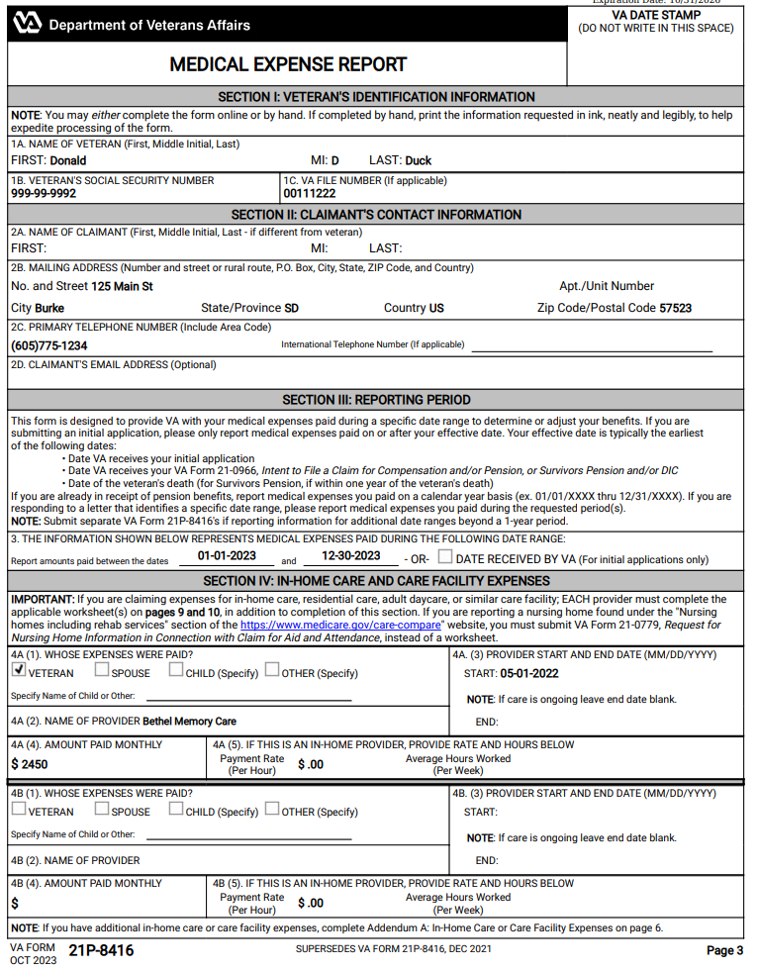
How to Complete a VA Form 21-8416

Slide 9
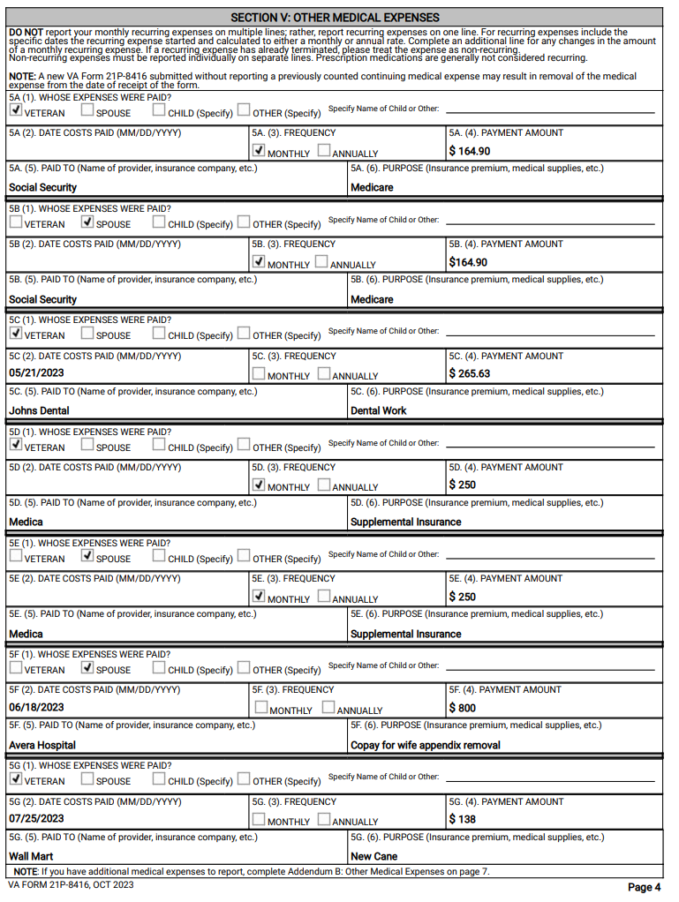
VA Form 21-8416 Continued

Slide 10
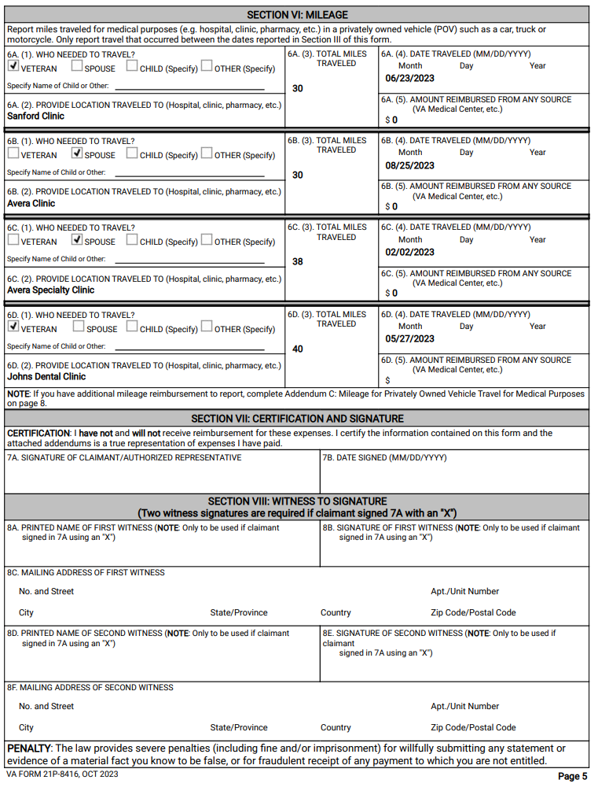
VA Form 21-8416 Continued

Slide 11
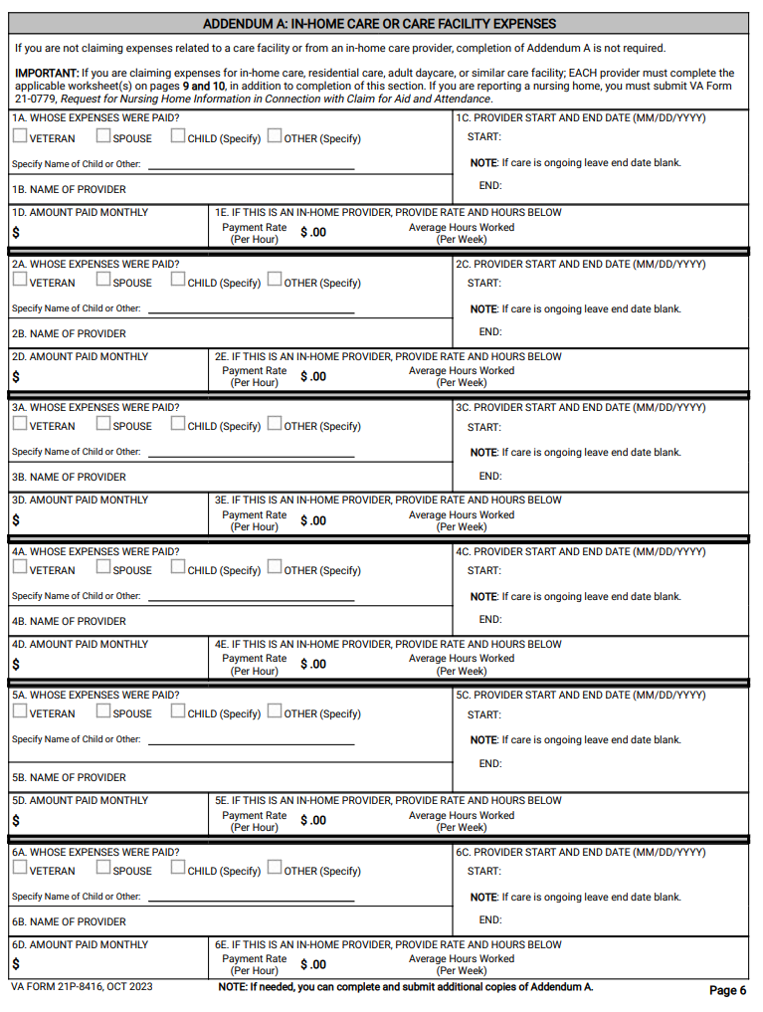
VA Form 21-8416 Continued

Slide 12
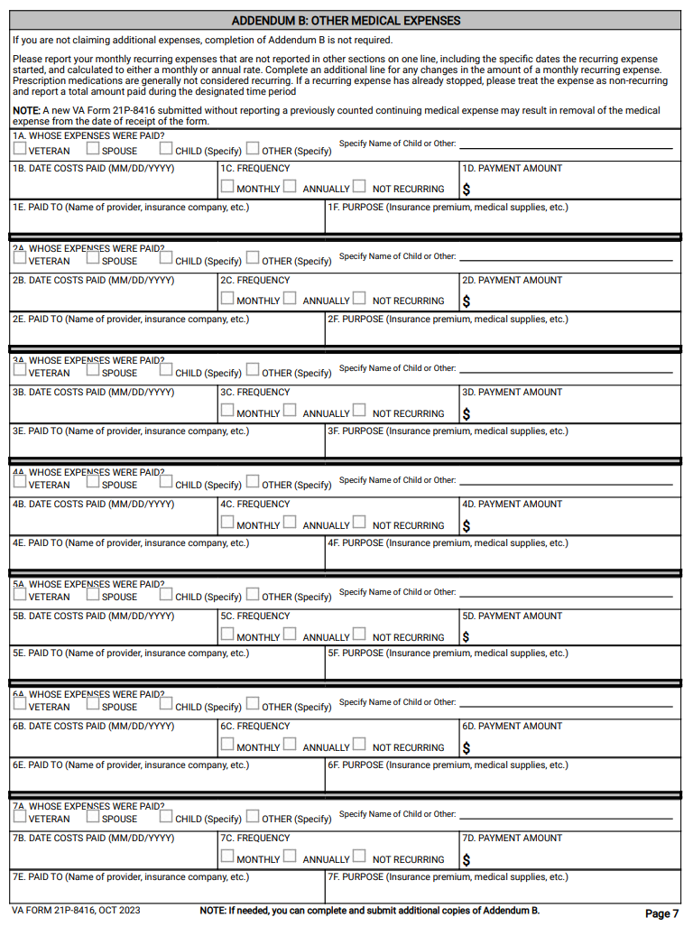
VA Form 21-8416 Continued

Slide 13
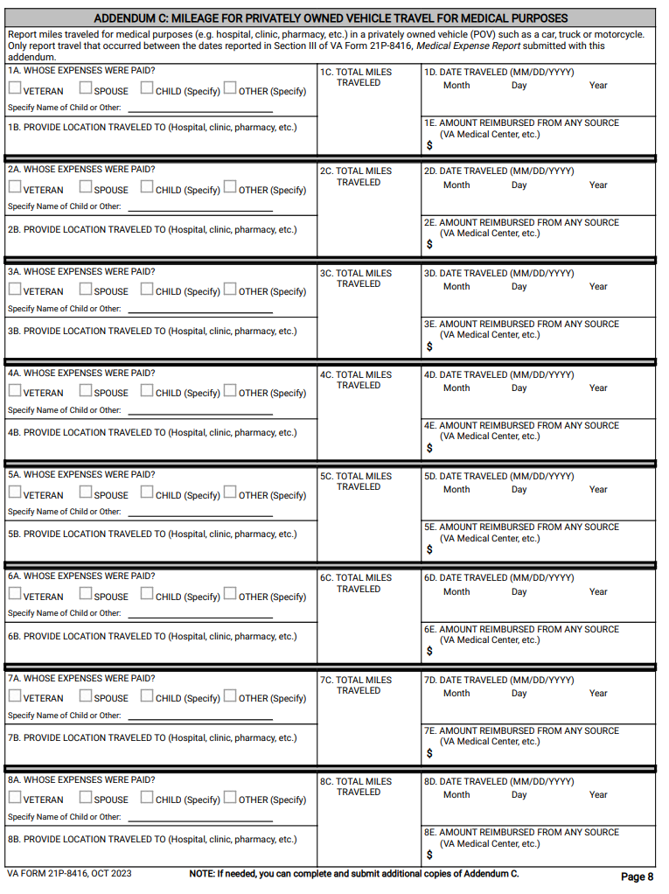
VA Form 21-8416 Continued

Slide 14
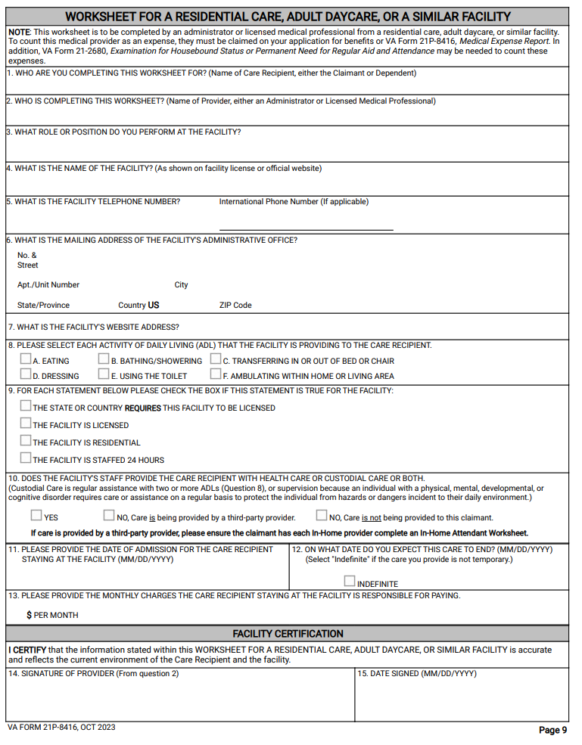
VA Form 21-8416 Continued

Slide 15
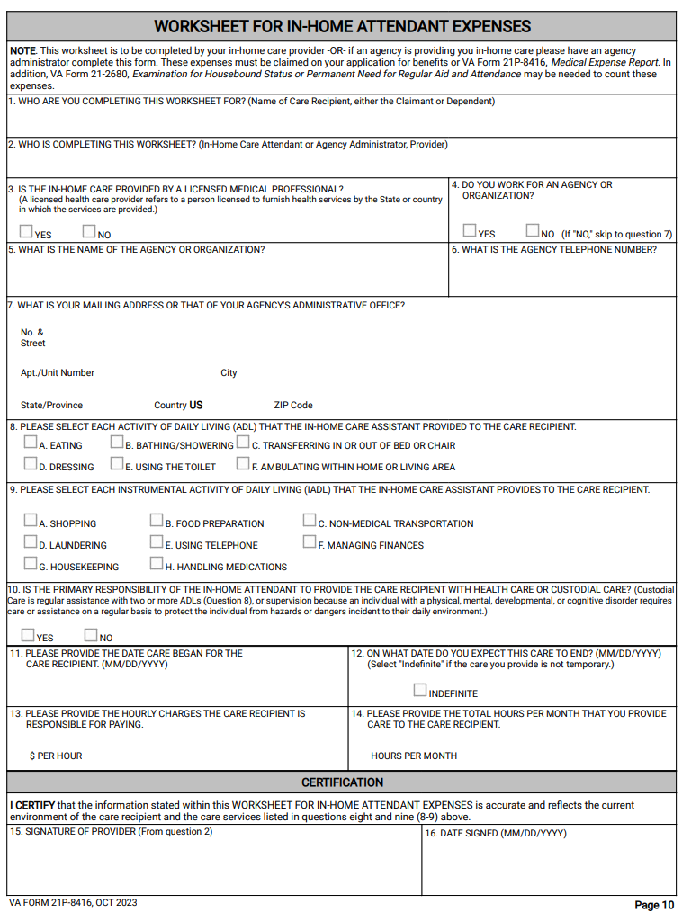
VA Form 21-8416 Continued

Slide 16
Fill Out a 21-8416 for the Next Year
It’s not a bad idea to fill out a VA Form 21-8416 and report the ongoing expenses for the next year.
If the claimants' expenses for insurance went up, you can do a VA Form 21-8416 to report the higher expenses for the next year.
The VA will calculate the higher amounts into the pension, which could help offset any Social Security increases for the next year.
But remember, only use ongoing predictable expenses.
Sometimes expenses go down, so that can also be reported to avoid overpayments.

Slide 17
Questions

